Slide 1
Automation Test Overview
Tien Nguyen
Sep 2021

Slide 2
What is Test Automation?
Why do we need automation?
Where can we apply automation test?
Automation test challenges
Continuous testing
Popular automation tools and frameworks
Table of Contents

Slide 3
What is Test Automation

Slide 4

What is Test Automation?
"In software testing, test automation is the use of special software (separate from the software being tested) to control the execution of tests and the comparison of actual outcomes with predicted outcomes." - wikipedia.org
Notes:
Automation + verification (assertions)
Demo playwright

Slide 5
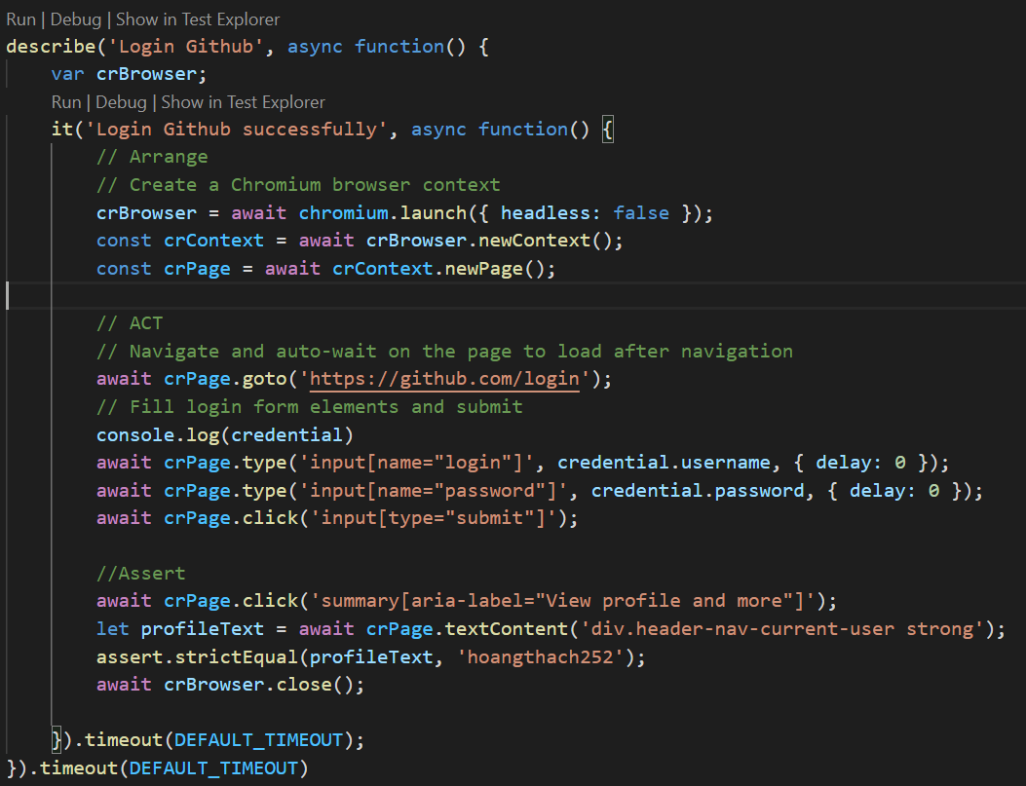
Automation Test

Slide 6
“ Tools don’t test. Only people test. Tools only perform actions that “help” people test. “
-- James Bach --

Slide 7
Why do we need to automation?

Slide 8



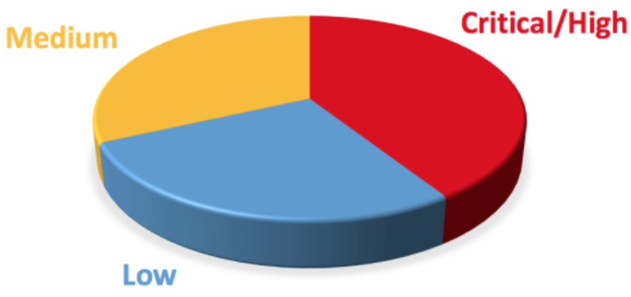
Pitfalls of Manual Testing
Time Consuming
Resources Consuming
Human are error-prone
Less Test Coverage
Notes:
It uses a lot of resources
It’s time consuming
It sometimes lacks proper coverage
Manual Testing can become boring and hence error-prone and inconsistencies.

Slide 9
Why Test Automation ?
More test coverage can be run per build
Tests run faster, less execution time
More effective and efficient use of testing resources
Reduce human mistakes.
The possibility to create tests that cannot be done manually (real-time, remote, parallel tests)
Quickly Determine the Stability of Your Build
Quicker feedback regarding software quality
Less stress on QA Team
Reducing the total test cost (long term)
Faster time to market
Notes:
Example for cannot done by manual:
Coupon active
Place 1000 orders

Slide 10
Manual Test vs Automation Test Comparison
Manual Test
Automated Test
Manual testing is not accurate at all times due to human error, hence it is less reliable.
Manual testing is time-consuming, taking up human resources.
Manual testing is practical when frequent repetition of test case execution is not required.
Investment is Low, ROI is Low
Manual testing allows for human observation, which may be more useful if the goal is user-friendliness or improved customer experience.
Automated testing is more reliable, as it is performed by tools and/or scripts.
Automated testing is executed by software tools, so it is significantly faster than a manual approach.
Automated testing is a practical option when the test cases are run repeatedly over a long time period.
Investment cost is High, ROI is High
Automated testing does not entail human observation and cannot guarantee user-friendliness or positive customer experience.
Notes:
Value of automation test cannot be seen immidiately as they need time to build fw, to scripting…
guarantee user-friendliness or positive customer experience.
=> Change background color or text color of github signup.

Slide 11
Where can we apply automation test?

Slide 12


Kinds of system/application
Notes:
Captcha
Layout, look&feel
Run test on a specific device which not in automation solution.
Lightroom desktop – app: cannot automate
only check machine-interpretable results
Login page changing by optimizely.
Check currency rate

Slide 13
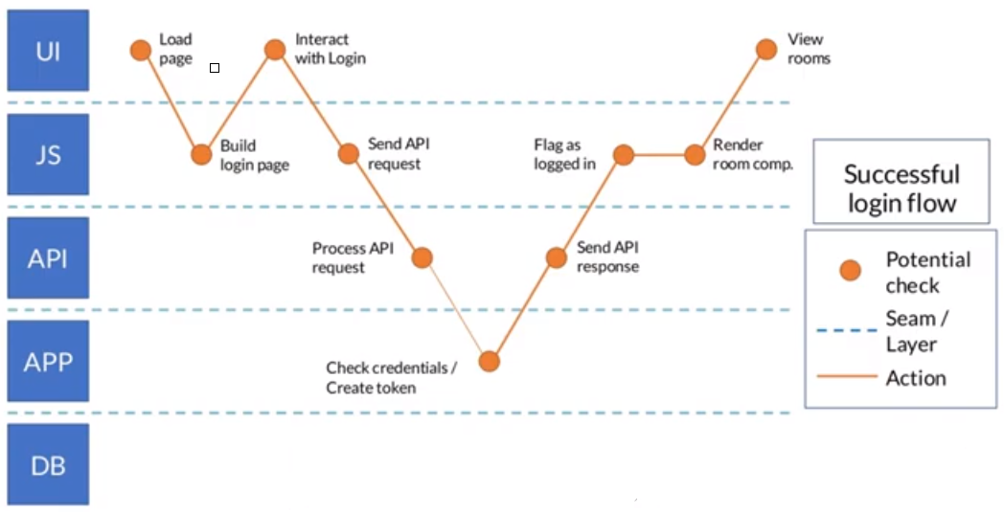
Automation Test Layer
Notes:
Explain modern web app architecture

Slide 14
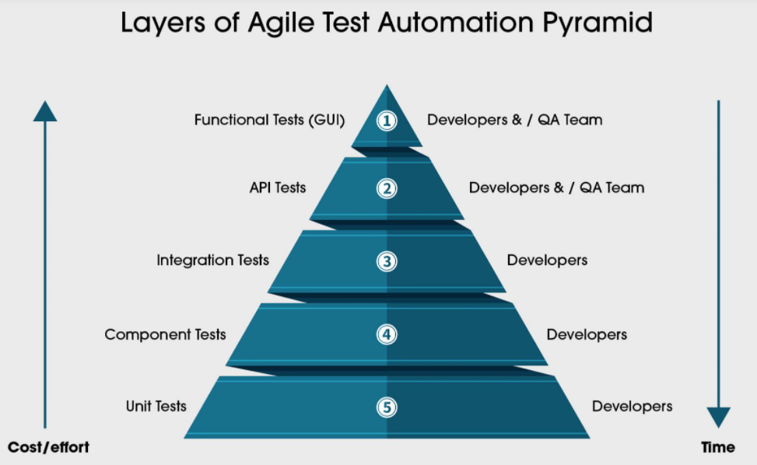
Test Automation Pyramid
Exploratory
Notes:
https://martinfowler.com/articles/practical-test-pyramid.htm
https://www.msystechnologies.com/resource/infographics/introduction-to-agile-test-automation-pyramid/l

Slide 15
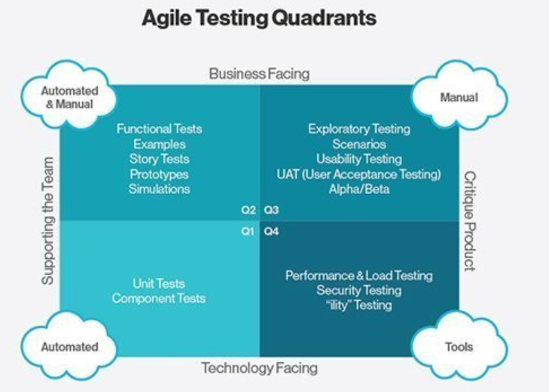
Testing Type
Notes:
https://www.tutorialspoint.com/agile_testing/agile_testing_quadrants.htm
Agile Testing Quadrants are derived by Brian Marick
The Agile Testing Quadrants provide a helpful taxonomy to help teams identify, plan and execute the testing needed.
Quadrant Q1 − Unit Level, Technology Facing, and supports the developers. Unit tests belong to this Quadrant. These tests can be Automated tests.
Quadrant Q2 − System level, business facing, and conform product behavior. Functional tests belong to this quadrant. These tests are either manual or automated.
Quadrant Q3 − System or User Acceptance Level, Business Facing and focus on real time scenarios. User Acceptance Tests belong to this quadrant. These tests are manual.
Quadrant Q4 − System or Operational Acceptance Level, Technology Facing and Focus on Performance, Load, Stress, Maintainability, Scalability Tests. Special tools can be used for these tests along with automation testing.

Slide 16
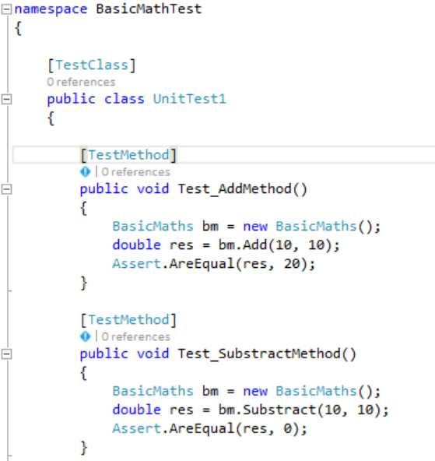
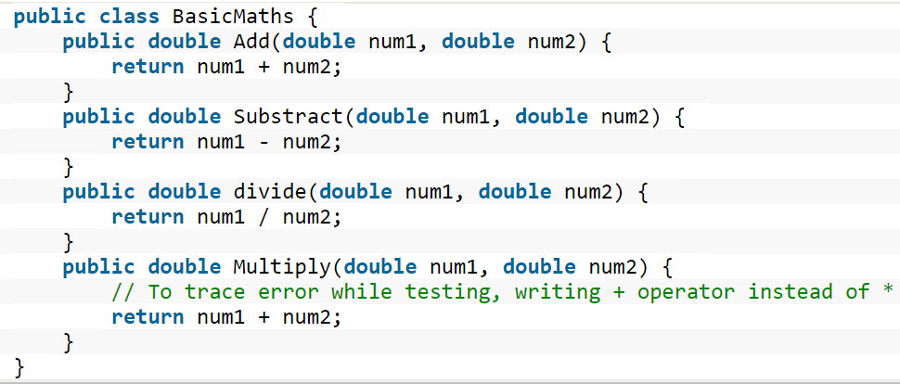
Unit test layer

Slide 17
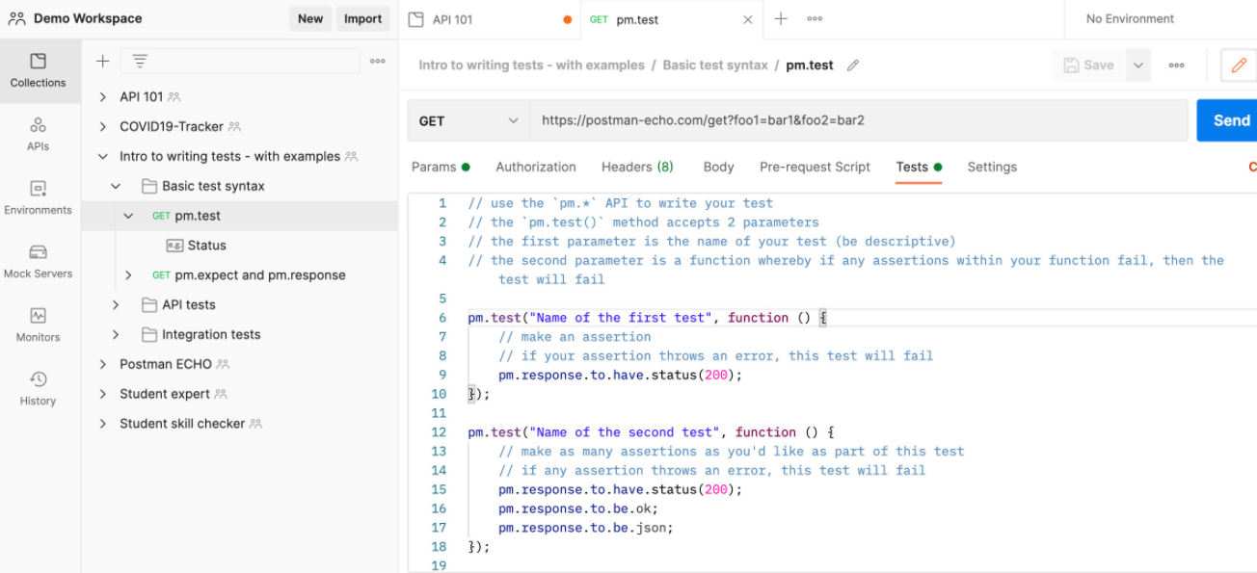
API functional test layer
Notes:
Login on UI
Same data , send login using api
Grab. Book over current balance, apply coupon => error.

Slide 18
UI Functional test layer

Slide 19
Select Test Cases to be Automated?
Should:
High Risk - Business Critical test cases
Test cases that are repeatedly executed
Test Cases that are very tedious or difficult to perform manually
Test Cases which are time-consuming
Test that are deterministic
Should Not:
Test Cases for which the requirements are frequently changing
Test cases which are executed on an ad-hoc basis.
Automate UI tests too early where the designs is not stable
Notes:
500 TCs can be executed in 1 day by manual testing
But it can take few month to be automated => prioritize wisely which tests should be automated first

Slide 20
Automation test challenges

Slide 21
Disadvantages & Limitations of Automation Test
Additional costs are involved
Initial investment to setup Test Automation Solution
On-going maintenance effort requirement
Can distract from testing objectives
Additional errors may be introduced by automation
Not all manual tests can be automated
The automation can only check machine-interpretable results
Notes:
Captcha
Layout, look&feel
Run test on a specific device which not in automation solution.
Lightroom desktop – app: cannot automate
only check machine-interpretable results
Login page changing by optimizely.
Check currency rate

Slide 22
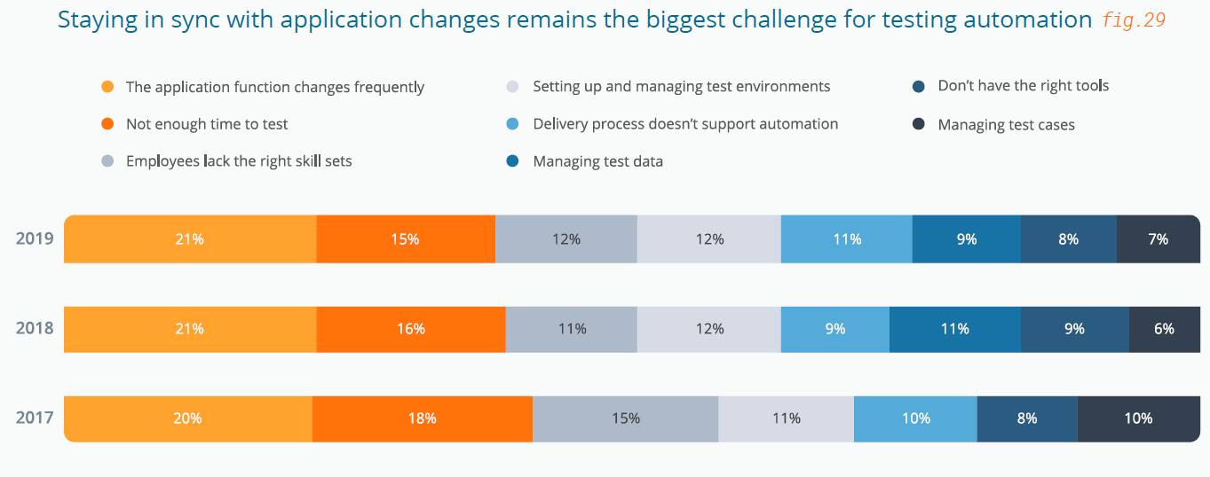
Automation Test Challenges

Slide 23
Good Mindset
Testers should start getting closer to developers, partly to better understand what they are doing, partly to help them with refining and improving their testing skills.
Developers should become even more aware of the importance of testing and start looking beyond plain happy-flow testing in their unit and integration tests
Automation test is a not completely replacement for Manual testing
Treat Automation project as another Software Development Project

Slide 24
Continuous Testing

Slide 25
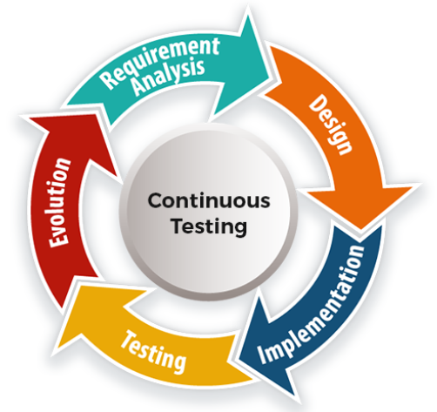
Continuous Testing vs Automation Testing
Continuous testing is an evolution of test automation. It leverages automated tests to ensure that testing happens continuously.
Faster feedback for each build
Quick release turnaround
Notes:
https://www.tricentis.com/products/what-is-continuous-testing/
https://en.wikipedia.org/wiki/Continuous_testing
Continuous Testing Definition: 14 Key Points
1. Continuous Testing’s primary goal is assessing business risk coverage 2. Continuous Testing provides instant insight on whether a release candidate is too risky to proceed through the delivery pipeline 3. Continuous Testing establishes a safety net that helps the team protect the user experience in accelerated development processes and avoid software failure headlines 4. Continuous Testing expects testing to be embedded within the development process, not tacked on at the end 5. Continuous Testing is seamlessly integrated into the software delivery pipeline and DevOps toolchain 6. Continuous Testing expects a stable test environment with valid test data to be available for each and every test run 7. Continuous Testing embraces everything from “shift left” (unit, component, coverage…) to “shift right” (monitoring/ APM, Testing in Production)
8. Continuous Testing involves executing the right set of tests at the right stage of the delivery pipeline—without creating a bottleneck
9. Continuous Testing delivers actionable feedback appropriate for each stage of the delivery pipeline
10. Continuous Testing evaluates each layer of a modern architecture at the appropriate stage of the delivery pipeline
11. Continuous Testing includes end-to-end tests that realistically assess the end-user experience across all associated technologies (front-end and back-end)
12. Continuous Testing’s tests must be broad enough to detect when an application change inadvertently impacts functionality that users have come to rely on
13. Continuous Testing reduces false positives by prioritizing robust, flexible modern test frameworks over brittle scripts
14. Continuous Testing involves continuously reviewing and optimizing the test suite to eliminate redundancy and maximize business risk coverage

Slide 26
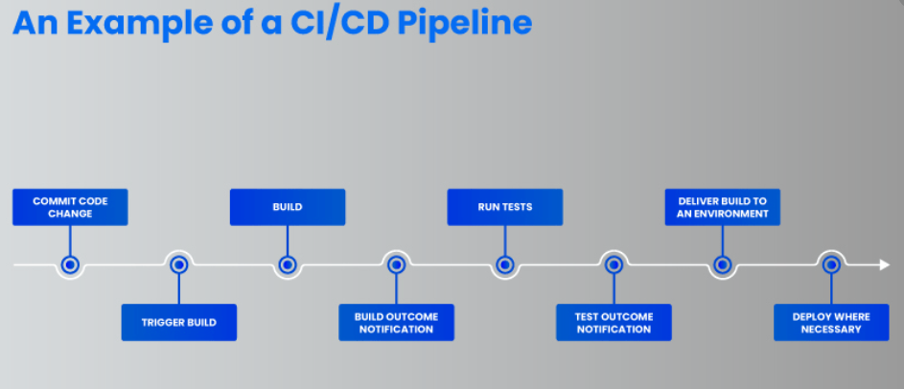
Continuous Testing

Slide 27
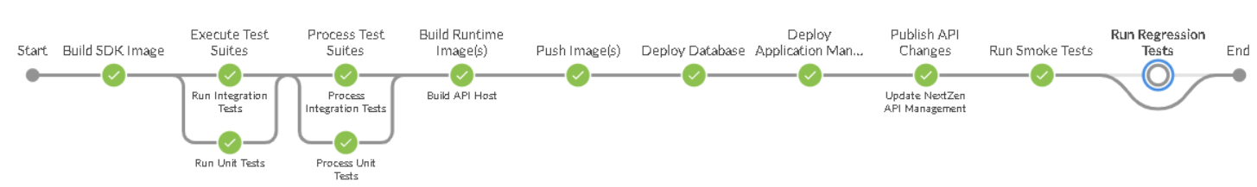
Continuous Testing

Slide 28
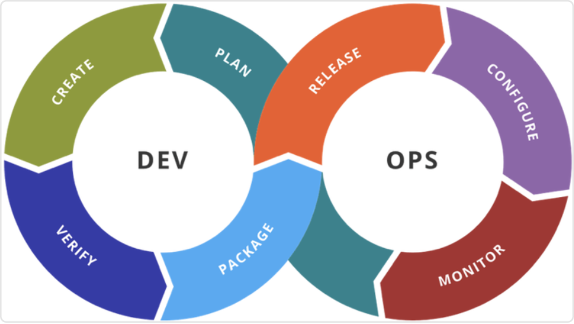
Shift Left Testing
“Shift-left testing is an approach to software testing and system testing in which testing is performed earlier in the lifecycle (i.e. moved left on the project timeline)” _Wikipedia_
Involve Testers to early phases
Coding Standards
Embrace Test Automation
Notes:
https://www.impactqa.com/blog/why-choose-shift-left-and-shift-right-testing-approach/
https://www.testim.io/blog/shift-left-testing-guide
https://en.wikipedia.org/wiki/Shift-left_testing
The “shift left” testing movement is about pushing testing toward the early stages of software development. By testing early and often, a project can reduce the number of bugs and increase the quality of the code. The goal is to not find any critical bugs during the deployment phase that require code patching.
Cost of bug fix in late phase
Pros:
Less waiting related to testing activities
Test coverage goes up
Defects are found and fixed earlier
Faster releases
How does Automation fit into Shift Left?
https://kms-technology.com/blog/testing/automation-in-shift-left-testing.html

Slide 29
Shift Right Testing
Aka “Testing in Production”
“There's no place like production”
uncover unexpected scenarios that may not have been detected within the development environment.
Chaos engineering
A/B testing
Canary releases
Synthetic monitoring
CX testing and analytics
Notes:
https://www.impactqa.com/blog/why-choose-shift-left-and-shift-right-testing-approach/
https://docs.microsoft.com/en-us/devops/deliver/shift-right-test-production
Some of the key TestOps shift-right practices:
Chaos engineering: this includes testing the reliability of the system through the injection of controlled failure scenarios.
A/B testing: consists of a randomized experiment with two (or more) variants to study which are more effective with users.
Canary releases: consists of techniques used to reduce the risk of introducing a new software version in production by gradually rolling out the change to a small subgroup of users, before rolling it out to the entire platform/infrastructure and making it available to everybody.
Synthetic monitoring: includes monitoring techniques using an emulation or scripted recordings of transactions (that reflect typical user behavior).
CX testing and analytics: includes extracting of CX data to understand customer experience as well as to derive insights from it (such as customer problems, new feature requirements, etc.).
Other testing in production: includes performance tests and testing of AI-based applications.
Testing insights from AIOps data: as described above, a rich variety of testing insights can be gleaned from operations data.

Slide 30
Popular automation tools and frameworks

Slide 31




















































Popular Automation Tools
Foundation
UI Test
Automated API Test
Supported Tools
Non-functional Tools
Visual Validation
Test Management
Report

Slide 32
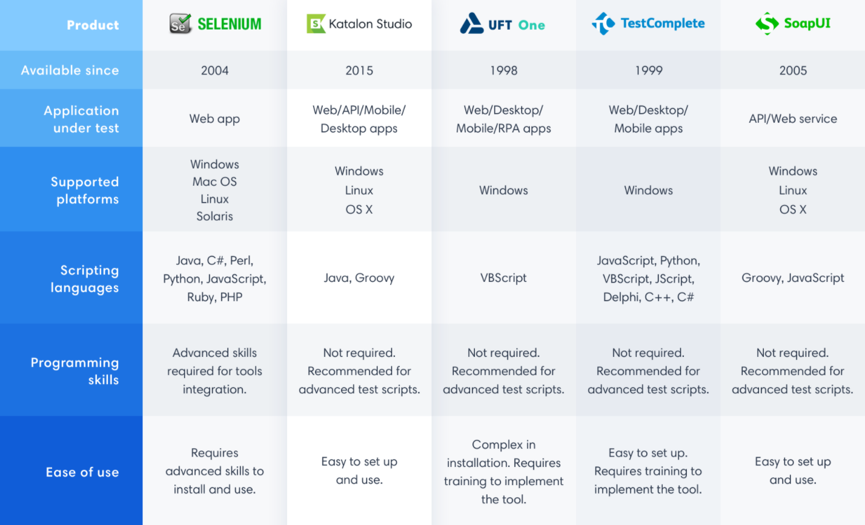

Slide 33







Common Automation Testing Frameworks
Notes:
http://www.softwaretestinghelp.com/test-automation-frameworks-selenium-tutorial-20/
WebDriverIO: NodeJs (Web and mobile)
Protractor: Angular, AngularJS application
A Test Automation Framework is a set of guidelines like coding standards, test-data handling, object repository treatment etc... which when followed during automation scripting produces beneficial outcomes like increased code re-usage, higher portability, reduced script maintenance cost etc. These are just guidelines and not rules; they are not mandatory and you can still script without following the guidelines.

Slide 34

Cucumber-JVM framework

Slide 35

Pytest Framework

Slide 36

Notes:
What is Automation Test
Test automation Pros and Cons
Automation testing level/layer
What is Shift Left Testing, how automation involve
What is Shift Right testing, how automation involve

